Slide 1
PRESENTATION ON FLIGHT PRICE PREDICTION USING ML
Submitted by
R. Sujanitha

Slide 2
TABLE OF CONTENTS
INRODUCTION -
Business Problem Framing
Conceptual Background Of Domain Knowledge
Motivation for the Problem Undertaken
ANALYTICAL PROBLEM FRAMING -
Data Sources and their formats
Data Preprocessing Done
Hardware and Software Requirements and Tools Used

Slide 3
EXPLORATORY DATA ANALYSIS
Visulaizations
Pie Charts
Bar Graphs
CONCLUSION
Key Findings and Conclusions

Slide 4
Flight Price Prediction
Customers are seeking to get the lowest price for their ticket, while airline companies are trying to keep their overall revenue as high as possible and maximize their profit.
India is the third-biggest avionics showcase in 2020 and the biggest by 2030.
From the customer point of view, determining the minimum price or the best time to buy a ticket is the key issue. The conception of ‘‘tickets bought in advance are cheaper” is no longer working (William Groves and Maria Gini, 2013)
According to Y. Chen et al. (2015) , predicting the actual ticket price is a more difficult task than predicting an optimal ticket purchase time due to various reasons.
The higher the level of competition, the weaker of the market power of an airline, & then the less likely the chance of the airline fare increases.
Tziridis et al. In his comparison, Bagging Regression Tree is identified as the best model, which is robust and not affected by using different input feature sets.
The presence of LCC in a market has had a substantial impact on the total passenger volume and the air ticket price.

Slide 5
Flight Price Prediction
It is a common practice for airlines to pass the cost of aviation fuel to the customer by adjusting the fare to compensate for the fluctuation of crude oil price.
In Another finding , When the flight is at a difference of 2-3 days’ time the ticket price starts increasing again.
Short distance flights are more elastic (more price sensitive) than long distance flights
Business class flights are more inelastic as compared to leisure class as business customers have less flexibility to change or cancel their travel date.

Slide 6
Business problem framing
Anyone who has booked a flight ticket knows how unexpectedly the prices vary. The cheapest available ticket on a given flight gets more & less expensive over time. This usually happens as an attempt to maximize revenue based on –
1. Time of purchase patterns (making sure last-minute purchases are expensive)
2. Keeping the flight as full as they want it (raising prices on a flight which is filling up in order to reduce sales and hold back inventory for those expensive last-minute expensive purchases)
So, you have to work on a project where you collect data of flight fares with other features and work to make a model to predict fares of flights
.

Slide 7
Hardware and Software Requirements and Tools Used
There is no such requirement for hardware ,but I have used intel processor.
Software: Jupyter Notebook (Anaconda 3), Microsoft Word, Microsoft PowerPoint
Language: Python
Libraries used in project:
Pandas
Numpy
Matplotlib
Seaborn

Slide 8
ANALYTICAL PROBLEM FRAMING

Slide 9
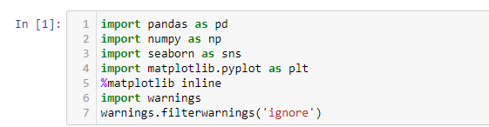
Data sources and their formats
Our data source is FlipRobo Technologies, who told to scrap the data using selenium from websites and store it and use it.
Before loading the dataset we imported some libraries for loading and analysing our dataset

Slide 10
Web Scraping strategy employed
Selenium will be used for web scraping data from www.yatra.com
Fights on route of New Delhi to Mumbai in duration of 7-Aug-2022 to 15-Aug-2022
Data is scrap in Economy class flight price extraction
Selecting features to be scrap from website
After extracting the flight details stored the data in the csv file

Slide 11


Data Set Information
Data set contain flight details on route New Delhi to Mumbai.
Dataset has 11 features like Airlines, Aeroplane, stops etc
There are 1521 rows and 11 columns present in the dataset

Slide 12
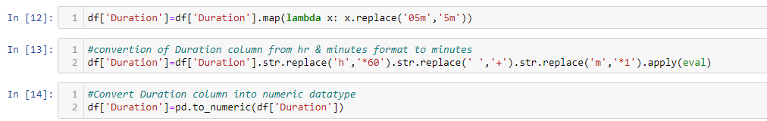

Data Preprocessing
Conversion of duration from Hours and minutes into minutes
New column Day & Date is extracted from Date column

Slide 13
Exploratory Data Analysis

Slide 14
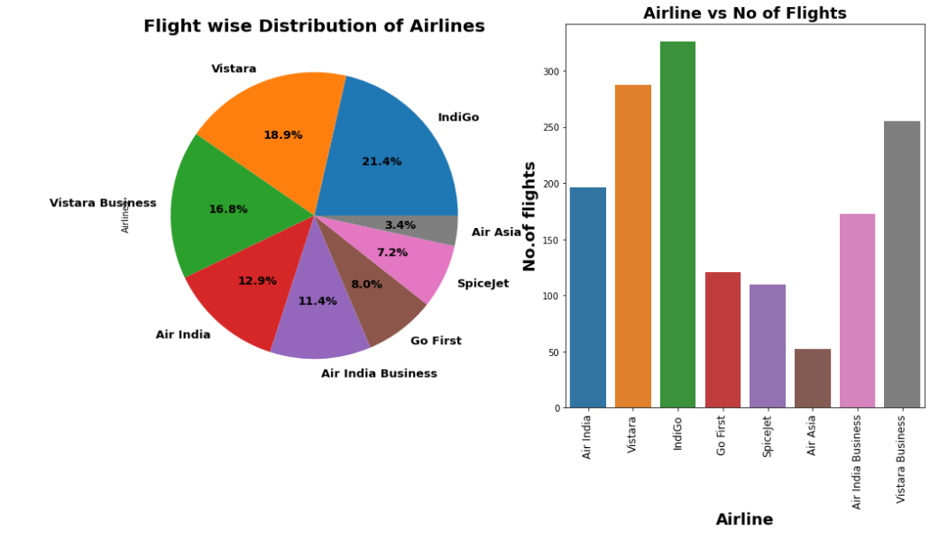
Flight wise Distribution of Airlines
Maximum number of flights are run by Vistara
minimum number of flights run by AirAsia

Slide 15
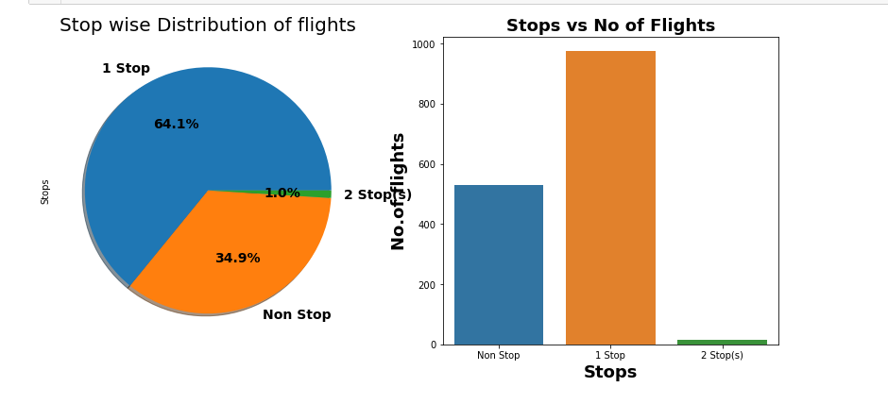
Stops-wise distribution of flights
64.1% flights take single stop in their way from New Delhi to Mumbai. It is also possible that these flights may have high flight duration compare to Non-stop flight.
34.9% of flights do not have any stop in their route

Slide 16
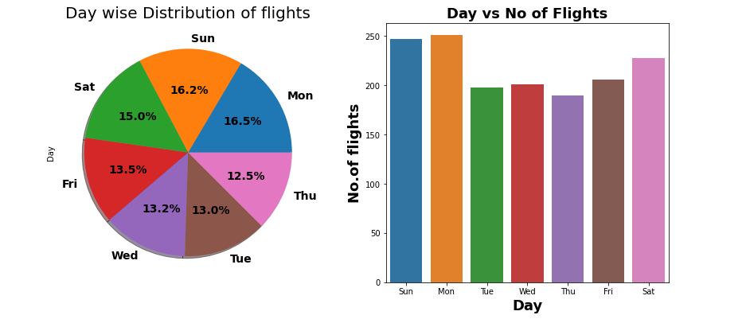
Day-wise Distribution of Flights
On Monday maximum number of flights run while on Thursday minimum number of flights run

Slide 17
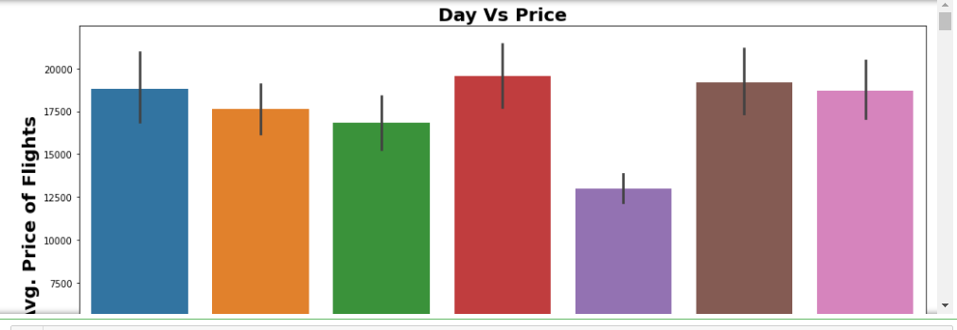
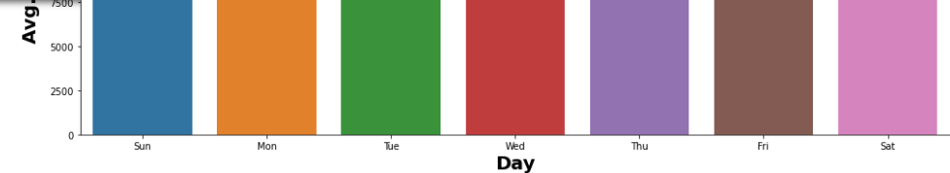
Day-wise Price
On Thursday the flight price is minimum from NewDelhi to Mumbai

Slide 18
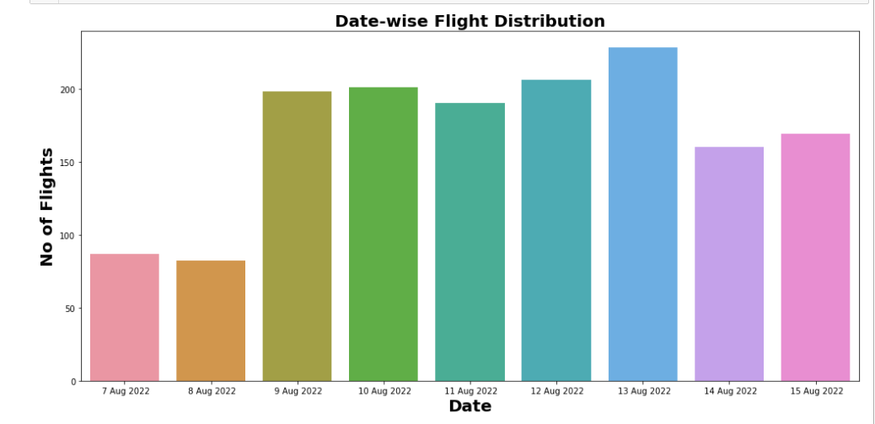
Date-wise Flight Distribution
We can see maximum flights scheduled on 13-Aug and minimum flights on 8-Aug

Slide 19
Machine Learning Model Building

Slide 20
This problem can be solved using regression based machine learning algorithm.
Methodology to build machine learning model:
Encoding categeorical data into Numerical
Scaling data using Standard Scalar
Splitting data into training & test using train test split from model selection
Implementing various Regression Based alogorithms to build ML model
Conducting 5 fold Cross validation
Hyper parameter tuning to best model
Saving Final model

Slide 21
Regression Algorithms Implementation
The different regression algorithms used in this project to build ML model are as below
Linear Regression
Random Forest Regressor
Decission Tree Regressor
Gradient Boosting Regressor

Slide 22
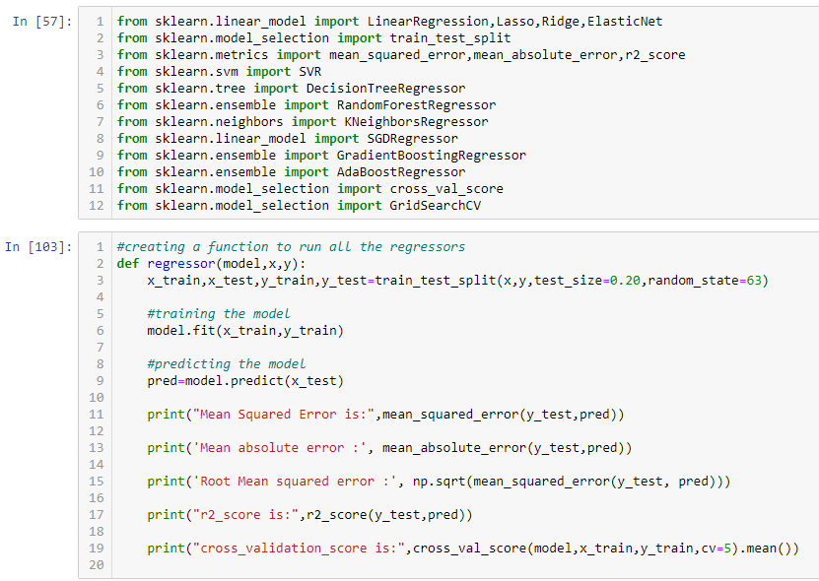
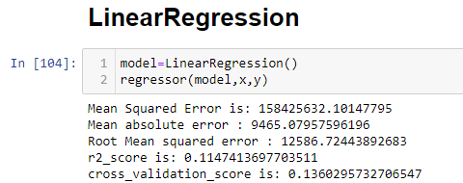

Slide 23
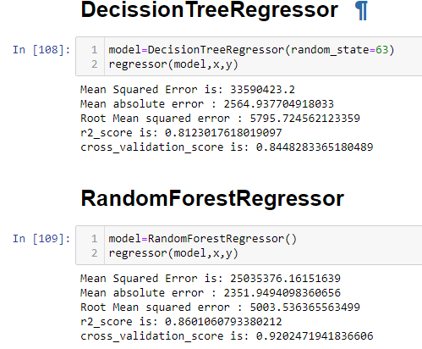
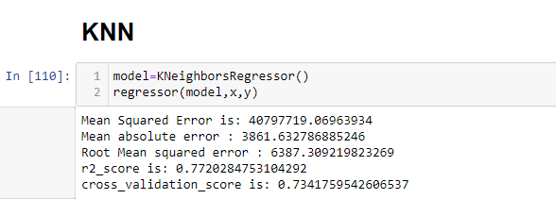

Slide 24
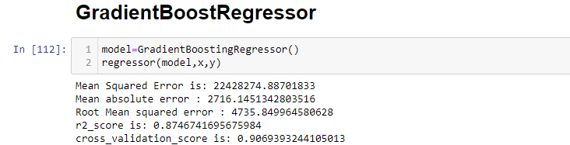
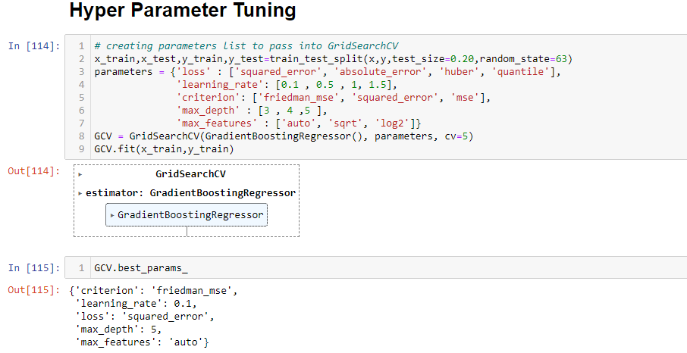
we are getting GradientBoostingRegressor r2_score as 87% and crossvalidation score as 90% so we accept this model and perform Hyper parameter tuning

Slide 25
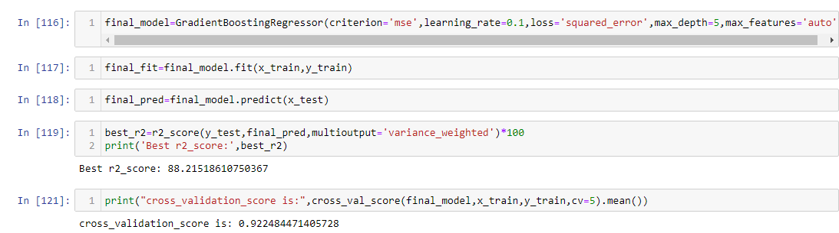
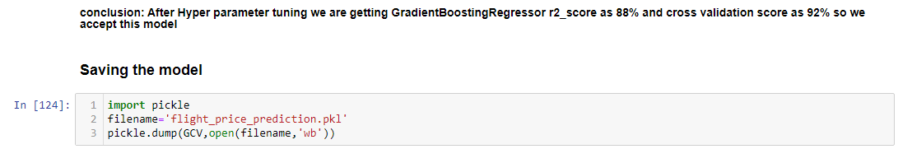

Slide 26
Limitations and Future Scope
In this study we focus on flights on route of New Delhi to Mumbai, more route can incorporate in this project to extend it beyond present investigation.
This investigation focus on short time frame (14 days prior flights take off) which can be extended variation over larger period.

Slide 27
Thank you

